Slide 1
CLOUD BASED CRM FOR AN INSTITUTION GROUP
PRESENTED BY,
AKHILA RAJ
Reg.No:KVE17MCA002
S6 MCA
Dept. Of COMPUTER APPLICATIONS
SNGCE , KADAYIRUPPU
GUIDED BY,
Ms. SMITHA K.S
Asst.Professor
Dept. Of COMPUTER APPLICATIONS

Slide 2
ABSTRACT
Customer relationship management (CRM) is a combination of people, processes and technology that seeks to understand a company's customers. It is an integrated approach to managing relationships by focusing on customer retention and relationship development. CRM has evolved from advances in information technology and organizational changes in customer-centric processes
A cloud-based CRM software for one of the leading institution group ( Name cannot be disclosed due to MOU) in Kerala.
The project develops a website for a complete CRM for handling every leads involved activities from social media's like Facebook, google ads..etc..
It is a system that hook up; the website of a institution group that is provided for the public and students, a course available on the institution group provided for the students, a module administrator manages the institution protocols, a module Lead Management is handling the leads from social media.

Slide 3
ADMIN MODULE
This module manages the institutions protocols. Tasks performed by admin are:
Primary Details: Admin can add primary details about the institution such as, institution name, contact details etc.
Admin can insert and edit details of each department in that institution
Admin can add new staff and new student details
Admin can add details about courses offered in that institution
Lead Source: Admin can able to check the source of lead
Activity: Admin can save the activity details (phone call, mail, walk-in)
Lead Stage: Admin can check the current stage of each lead

Slide 4
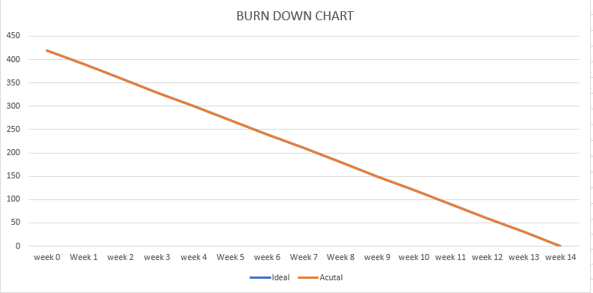
BURN DOWN CHART
IDEAL

Slide 5
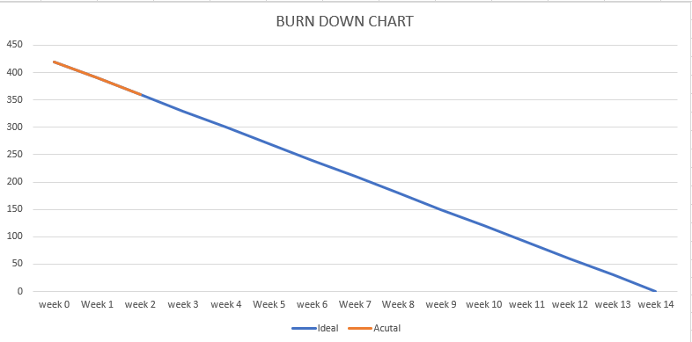
BURN DOWN CHART
SPRINT-1

Slide 6
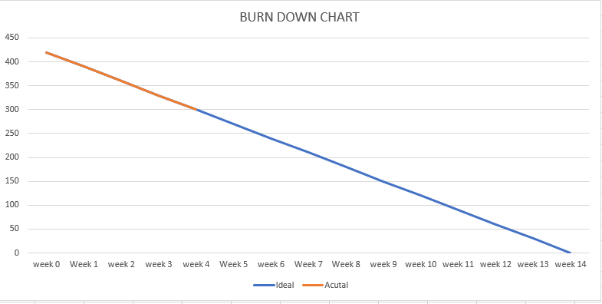
BURN DOWN CHART
SPRINT-2

Slide 7
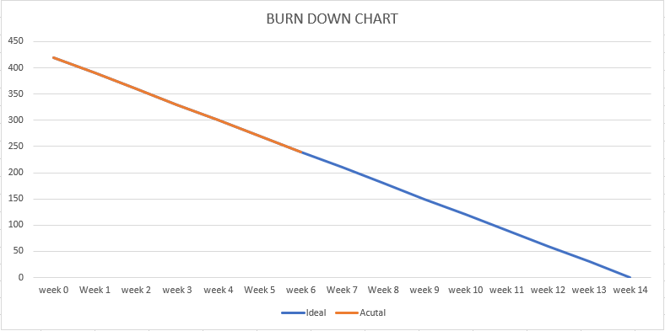
BURN DOWN CHART
SPRINT-3

Slide 8
TASK PERFORMED TILL LAST REVIEW
SPRINT | TASK PERFORMED
1 | Topic Selection
 | Feasibility Study
2 | Created Home Page
 | Created Login Page
 | Created Home Page For Admin
3 | Added Primary Details About College
 | Admin can Edit Primary Details About College
 | Everyone Can view Primary Details About College

Slide 9
SPRINT 4
SPRINT | START DATE | END DATE
4 | 24/02/2020 | 08/03/2020
TASK ID | DESCRIPTION | STATUS
4.1 | ADD DETAILS ABOUT NEW TEACHER | COMPLETED
4.2 | ADD DETAILS ABOUT NEW STUDENT | COMPLETED
4.3 | CREATE HOME PAGE FOR TEACHER | COMPLETED

Slide 10
FEATURE ID | SPRINT | USERSTORY | TASK | WEEK 1 | WEEK 2
4.1 | 4 | 4.1 | Added details about new teacher | YES
4.2 | 4 | 4.2 | Added details about new student | YES | YES
4.3 | 4 | 4.3 | Created Home Page for Teachers |  | YES

Slide 11
DAILY SCRUM MEETING – 4
Date | Feature ID | Sprint | What I Have Done Since The Last Sprint | What Will Do The Next Scrum Meeting | Are They Any Difficulties Faced
24/02/2020 | 4.1 | 4 | Added new teacher details | Add new student details | NO
01/03/2020 | 4.2 | 4 | Added new student details | Create Home Page for teachers | NO
05/03/2020 | 4.3 | 4 | Created Home Page for teachers | Create Home Page for students | NO

Slide 12
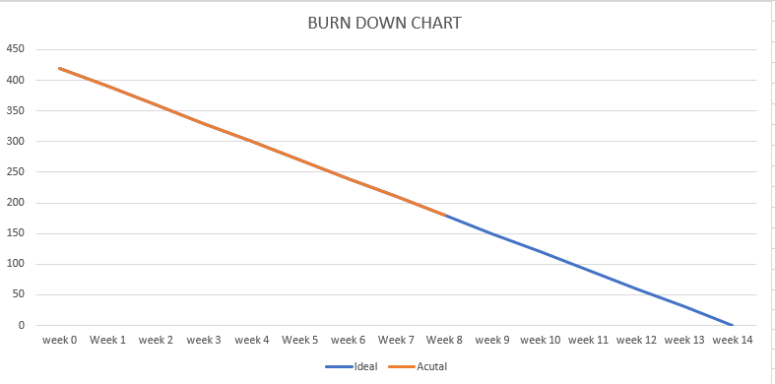
BURN DOWN CHART
SPRINT 4

Slide 13
SPRINT 5
SPRINT | START DATE | END DATE
5 | 09/03/2020 | 22/03/2020
TASK ID | DESCRIPTION | STATUS
5.1 | CREATE HOME PAGE FOR STUDENTS | COMPLETED
5.2 | ADD DETAILS ABOUT EACH DEPARTMENT | COMPLETED
5.3 | ADMIN CAN EDIT DETAILS ABOUT EACH DEPARTMENT | COMPLETED

Slide 14
FEATURE ID | SPRINT | USERSTORY | TASK | WEEK 1 | WEEK 2
5.1 | 5 | 5.1 | Created Home Page for Students | YES
5.2 | 5 | 5.1 | Added details about each department |  | YES
5.3 | 5 | 5.2 | Admin can edit details about each department |  | YES

Slide 15
DAILY SCRUM MEETING – 5
Date | Feature ID | Sprint | What I Have Done Since The Last Sprint | What Will Do The Next Scrum Meeting | Are They Any Difficulties Faced
09/03/2020 | 5.1 | 5 | Created Home Page for Students | Add department details | NO
14/03/2020 | 5.2 | 5 | Added details about each department | Admin can edit department details | NO
18//03/2020 | 5.3 | 5 | Admin can edit details about each department | Add details about Courses offered | NO

Slide 16
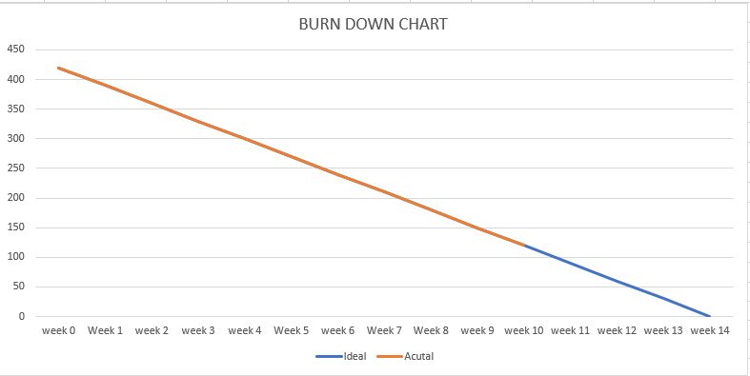
BURN DOWN CHART
SPRINT 5

Slide 17

SCREEN SHOTS
HOME PAGE

Slide 18
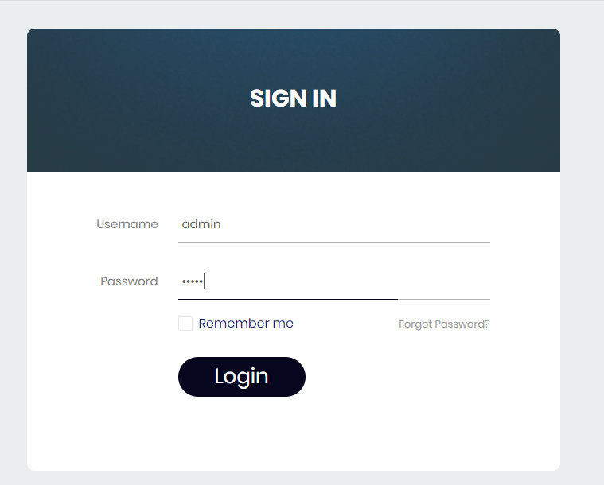
LOGIN PAGE

Slide 19
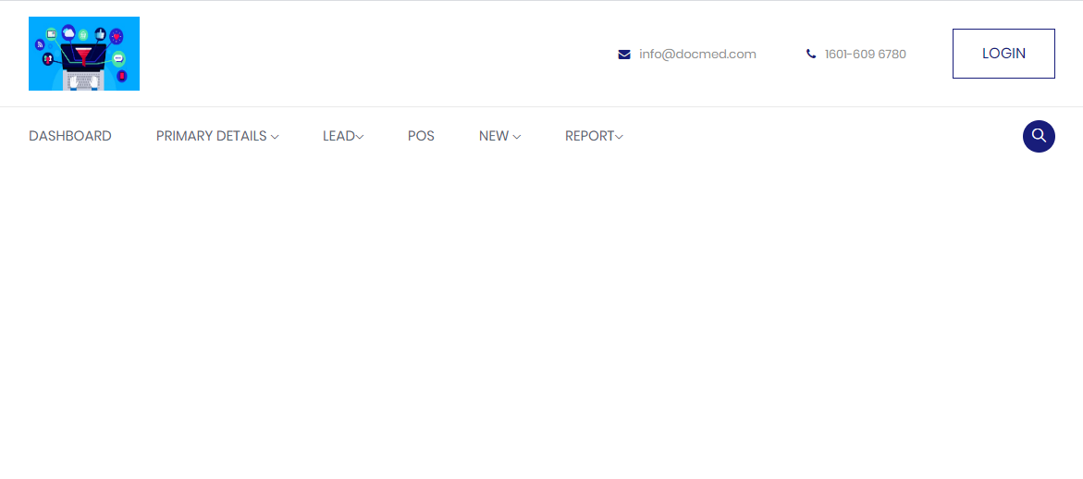
ADMIN HOME

Slide 20
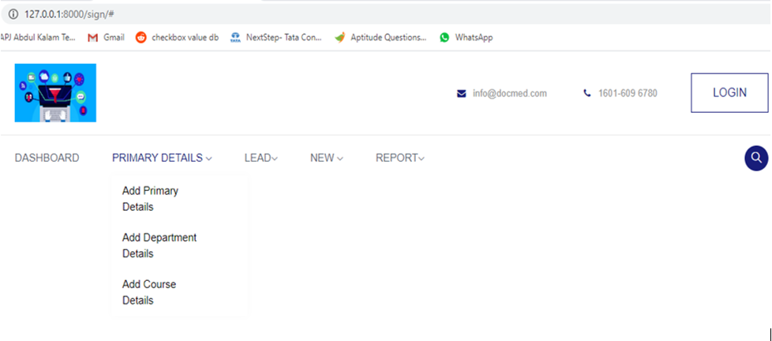

Slide 21
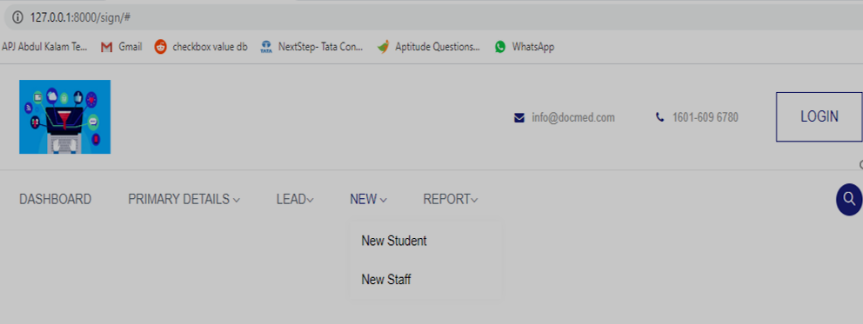

Slide 22
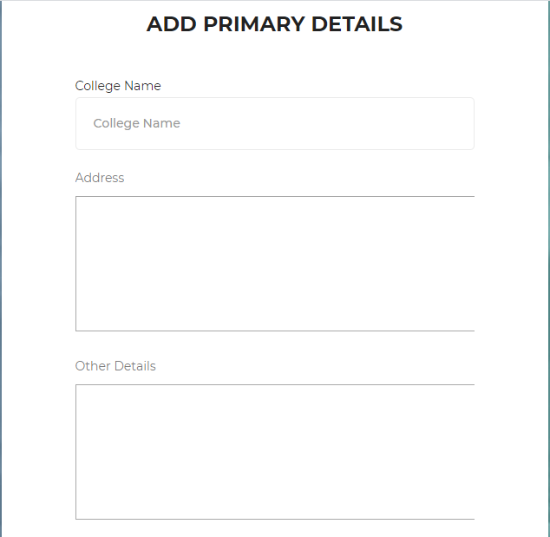
ADD PRIMARY DETAILS

Slide 23
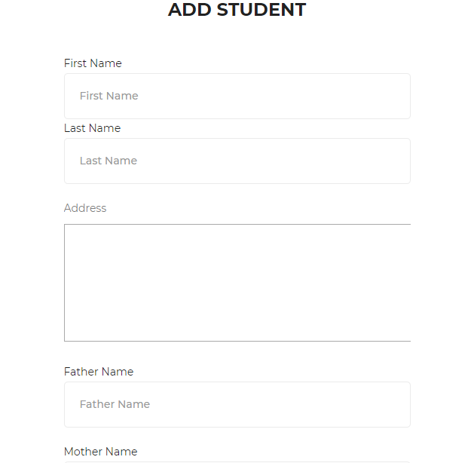
NEW STUDENT

Slide 24
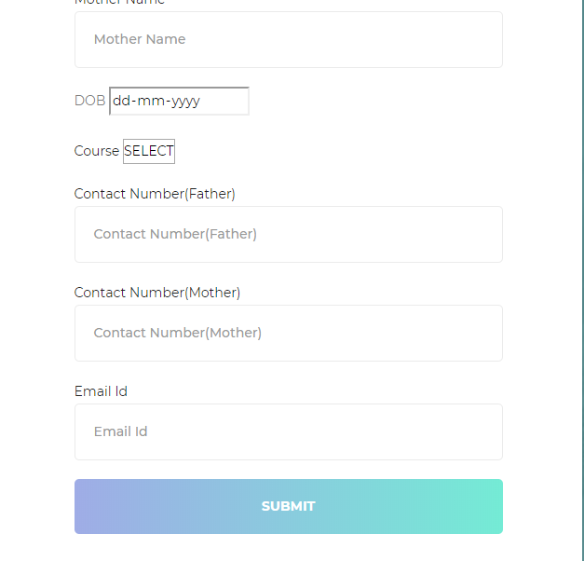

Slide 25
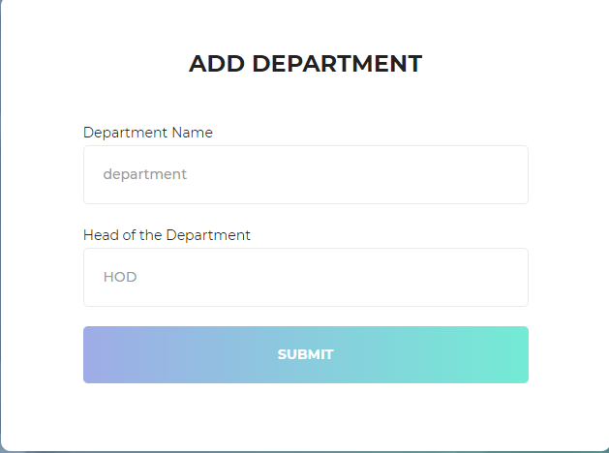
ADD DEPARTMENT DETAILS

Slide 26
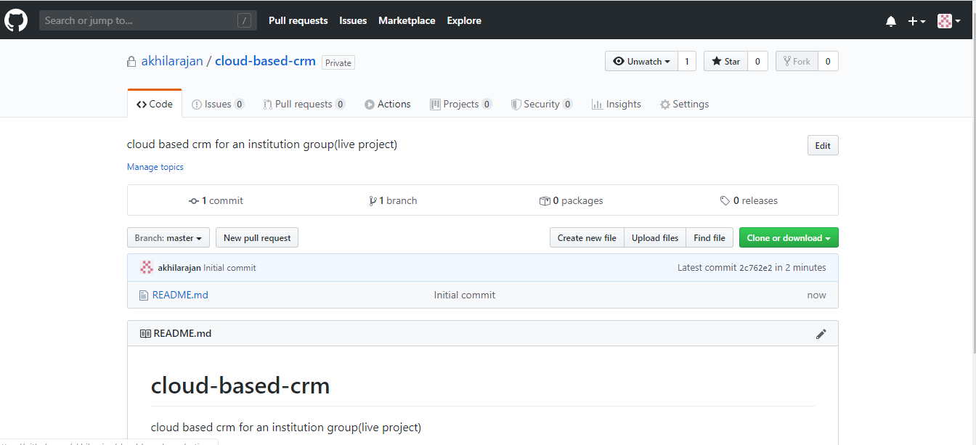
GIT HISTORY
REPOSITORY CREATION

Slide 27
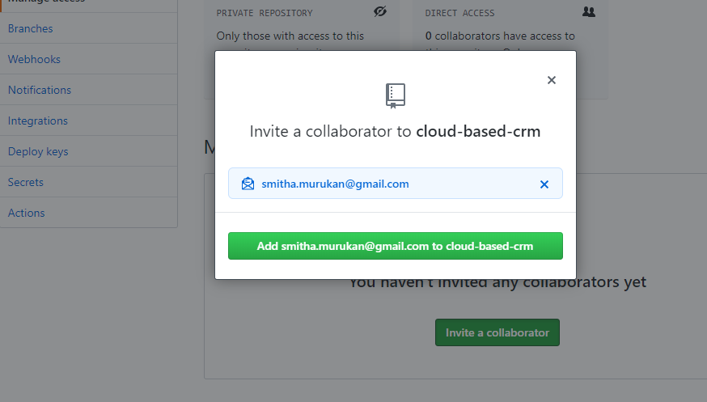
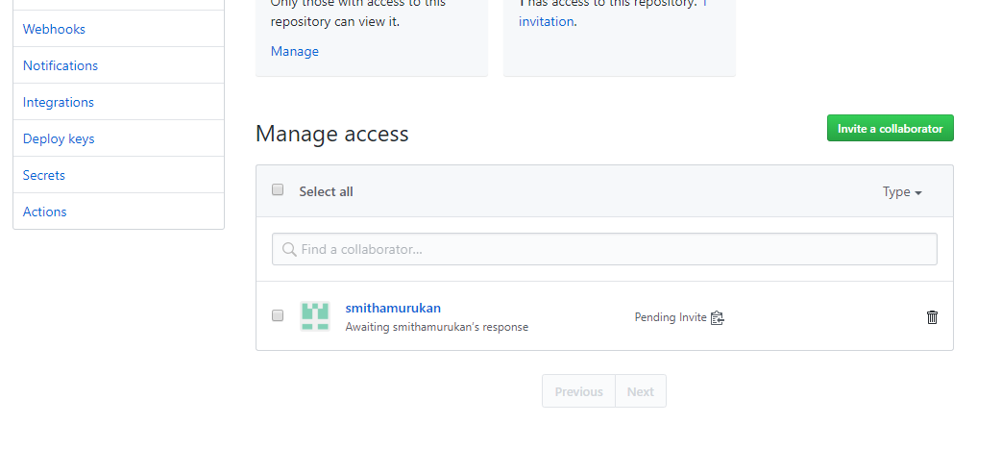
ADDING COLLABORATOR

Slide 28

THANK YOU.....

